Slide 1
Backpatching
A key problem when generating code for boolean expressions and flow-of-control statements is that of matching a jump instruction with the target of the jump.
For example S-> if ( B ) S1, S contains a jump when B is false.
We followed an approach like this before, Pass labels as inherited attributes to where the relevant jump instructions were generated. But a separate pass is then needed to bind labels to addresses.
In a one-pass translation, B must be translated before S is examined.
Backpatching is a one-pass translation approach.
In backpatching list of jumps are passed as synthesized attributes. Specifically, when a jump is generated, the target of the jump is temporarily left unspecified.
Each such jump is put on a list of jumps whose labels are to be filled in when the proper label can be determined. All of the jumps on a list have the same target label. We follow here the translation using position numbers.

Slide 2
One-Pass Code Generation using Backpatching
Backpatching can be used to generate code for boolean expressions and flow of-control statements in one pass.
Synthesized attributes truelist and falselist of nonterminal B are used to manage labels in jumping code for boolean expressions.
In particular, B:truelist will be a list of jump or conditional jump instructions into which we must insert the label to which control goes if B is true.
B:falselist likewise is the list of instructions that eventually get the label to which control goes when B is false.
As code is generated for B, jumps to the true and false exits are left incomplete, with the label field unfilled.
Statement S has a synthesized attribute, S.nextlist denoting a list of jumps to the instruction immediately following the code for S.

Slide 3
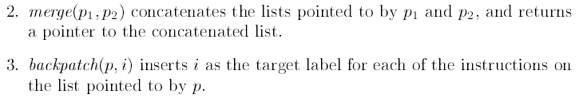
To manipulate list of jumps, three functions are used

Slide 4
Backpatching for Boolean Expressions
Now we will design a translation scheme suitable for generating code for boolean expression during bottom up parsing.
A marker nonterminal M in the grammar causes a semantic action to pick up, at appropriate times, the index of the next instruction to be generated.

Slide 5
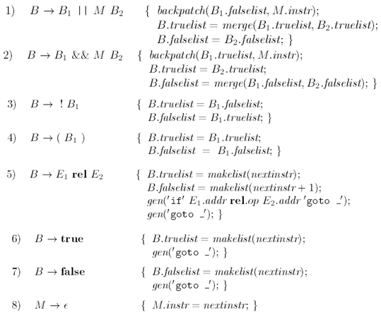
Translation Scheme for boolean expressions

Slide 6
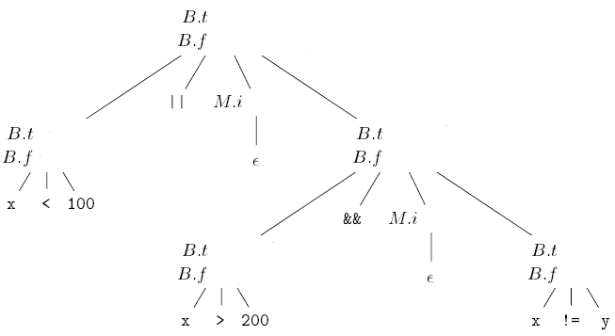





Attributes truelist, falselist, instr are represented by t,f and i respectively

Slide 7

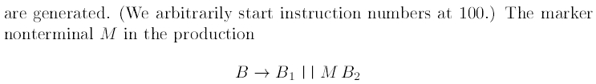


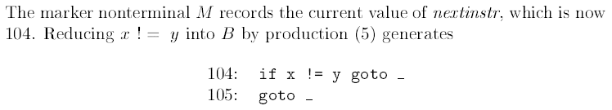
Control Flow Translation

Slide 8
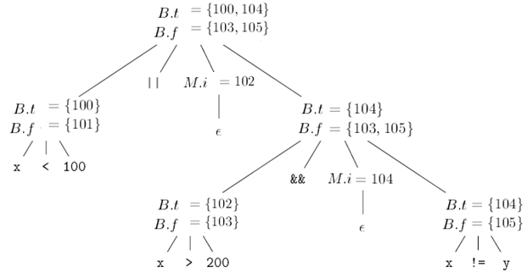


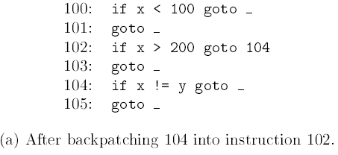
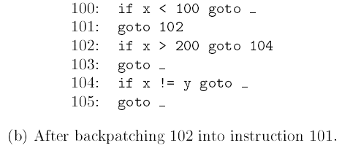
Translation using backpatching
Steps in the backpatching process

Slide 9

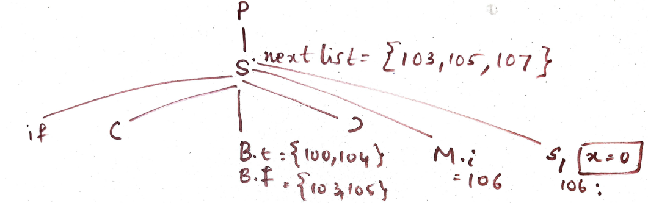

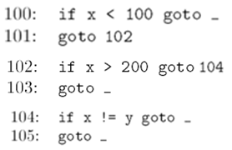
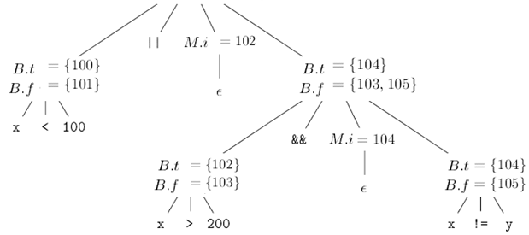

Translation of if statement through backpatching

